Slide 1
Portfolio Milestone
MS Applied Data science
Jeffrey Kao
SID 999002123

Slide 2

Key Learning Objectives
Describe a broad overview of the major practice areas in data science.
Collect and organize data.
Identify patterns in data via visualization, statistical analysis, and data mining.
Develop alternative strategies based on data.
Develop a plan of action to implement the business decisions derived from the analyses.
Demonstrate communication skills regarding data and its analysis for managers, IT professions, programmers, statisticians, and other relevant professional’s in their organization.
Synthesize the ethical dimensions of data science practice.

Slide 3
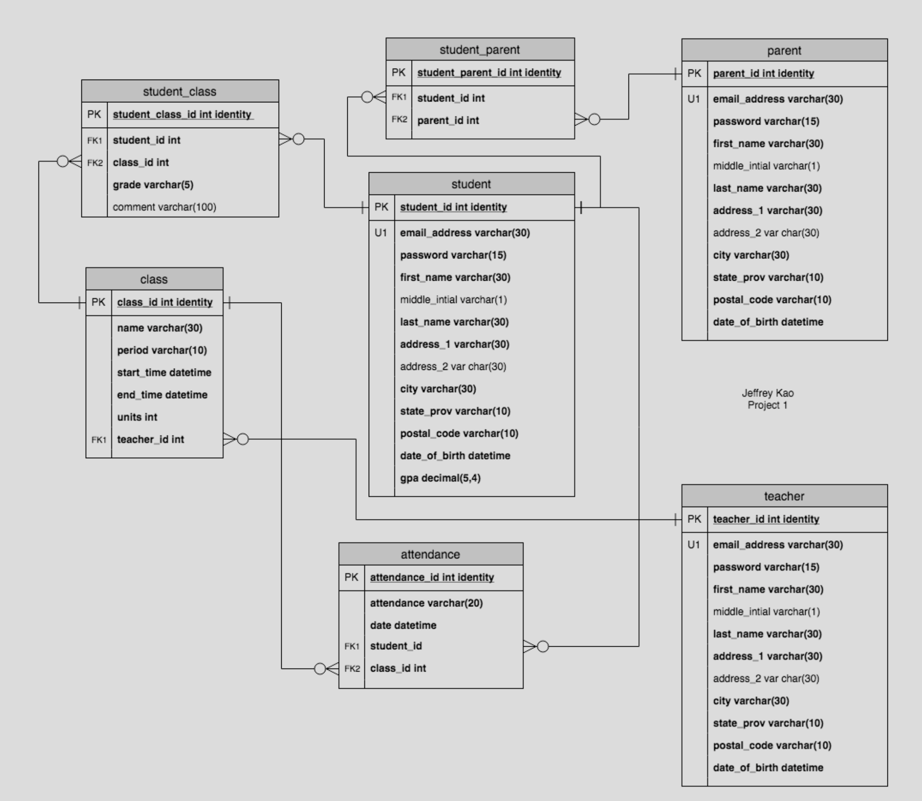
IST659: Data Admin Concepts & Database Management - High School Database

Slide 4
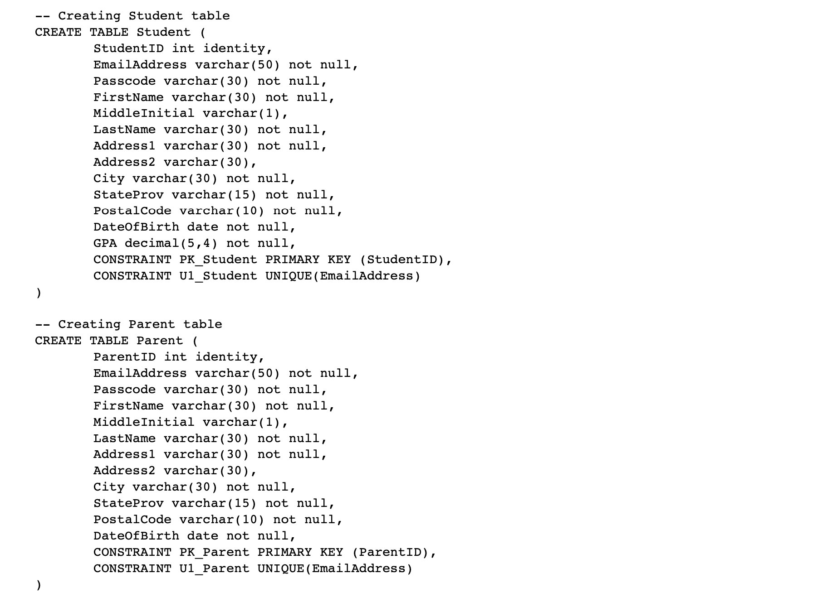
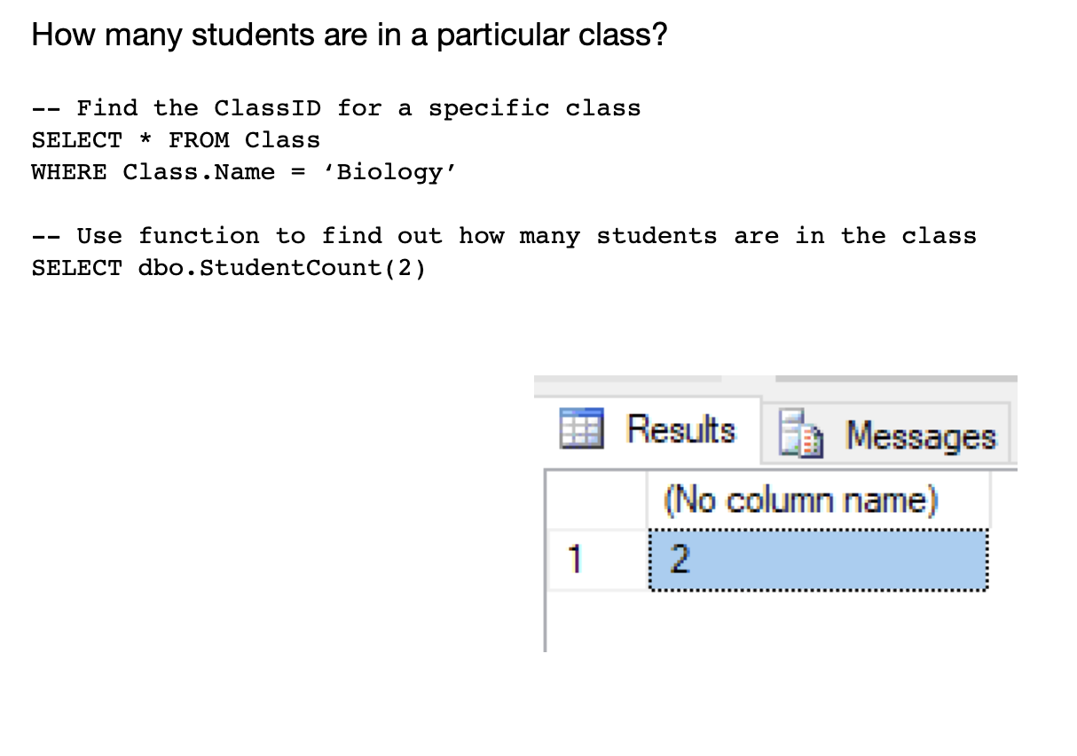
IST659: Data Admin Concepts & Database Management - High School Database

Slide 5
IST659: Data Admin Concepts & Database Management - High School Database
Learning Outcome
Databases are key major practice area in data science.
Collection and organization of data in database form.
Identify patterns via SQL queries.
Communication skills of data in the form of a database.

Slide 6
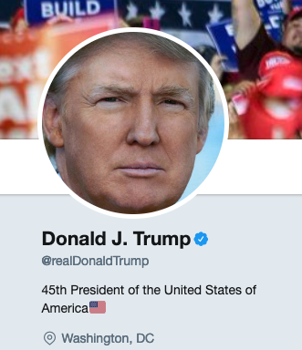
IST652: Scripting for Data Analysis - Trump’s Tweets
Used Twitter API to create json file of our President’s tweets
Pulled 3232 tweets
From 5-18-2018 to 3-17-2019

Slide 7
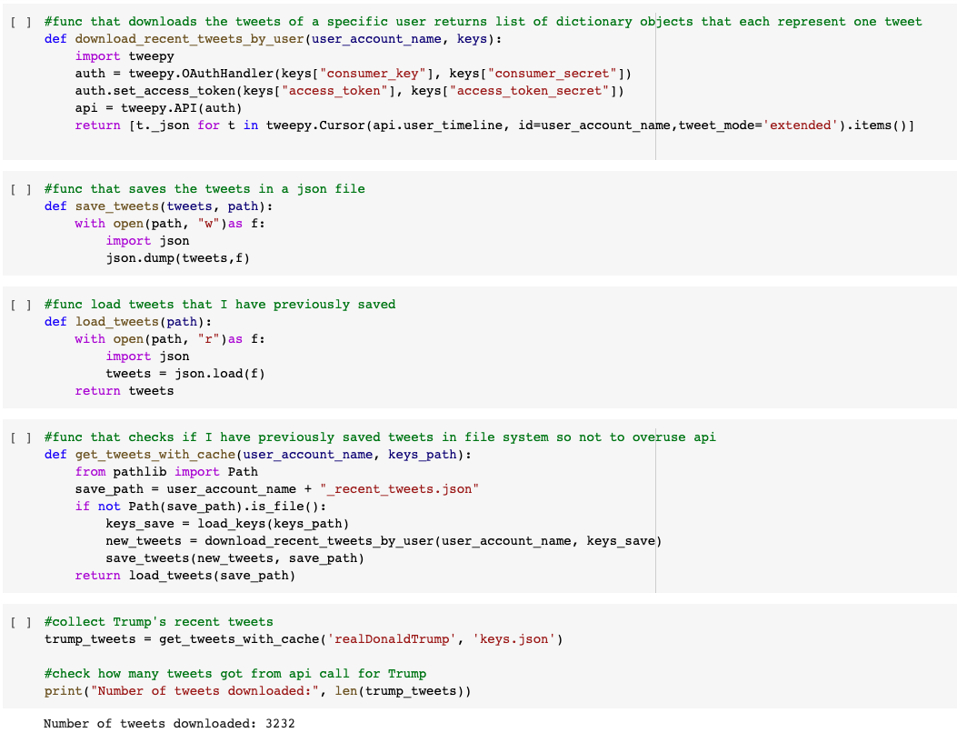
IST652: Scripting for Data Analysis - Trump’s Tweets

Slide 8
IST652: Scripting for Data Analysis - Trump’s Tweets

Slide 9
IST652: Scripting for Data Analysis - Trump’s Tweets

Slide 10
IST652: Scripting for Data Analysis - Trump’s Tweets
Learning Outcome
API are key major practice area in data science in data collection.
Collection and organization of data in from API and cleaning the data.
Identify patterns via visualizations, statistical analysis, and data mining.
Ethical dimensions of Twitter and the importance of inability to delete tweets.
Communication skills of data in form of presentation of tweets and relevant data.

Slide 11
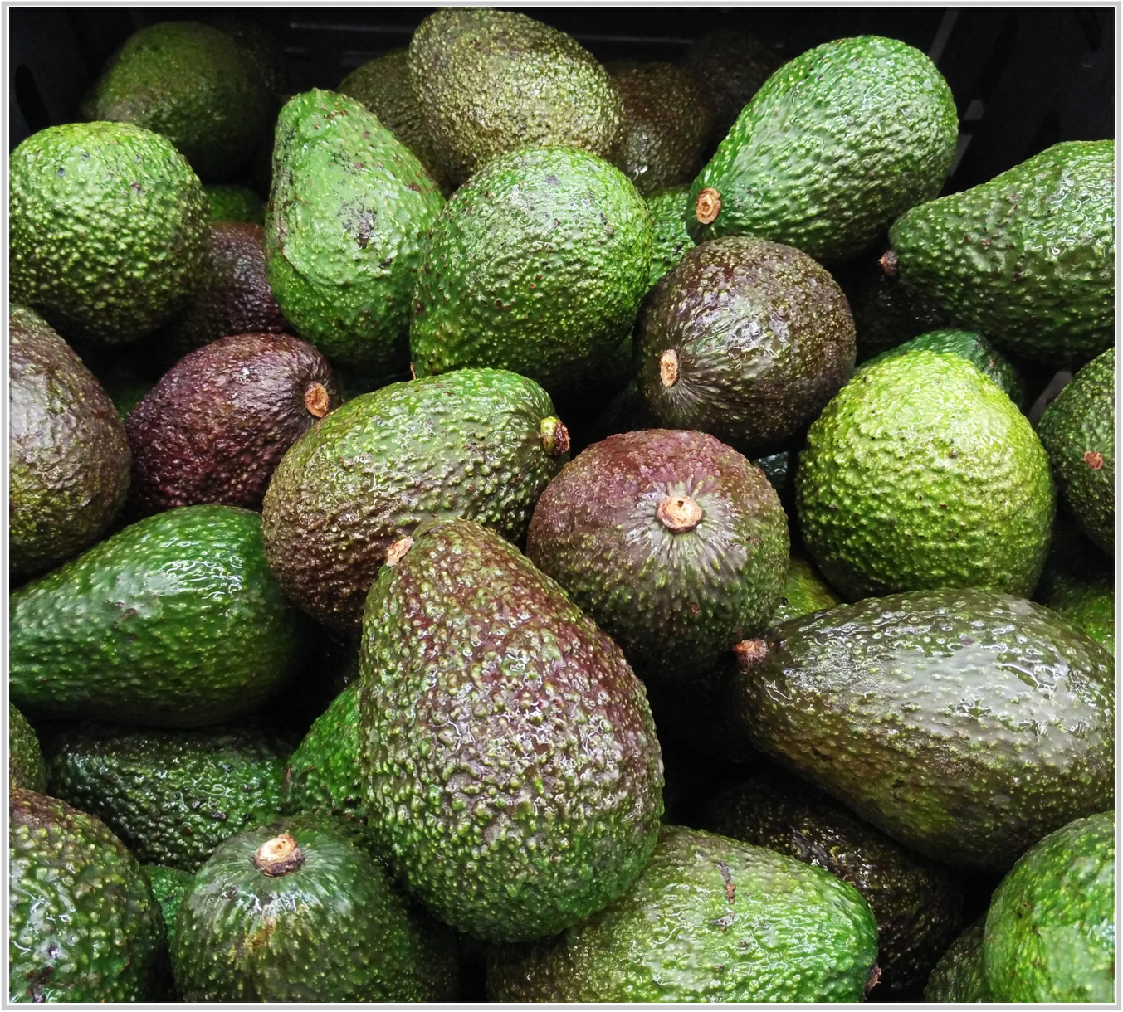
MAR653: Marketing Analytics - Analysis of Avocado Pricing and Distribution
Overview of the avocado market
Researching the different habits of avocado buyers
Understanding sales trends
Segmenting customers into clustered groups
Recommending future direction

Slide 12
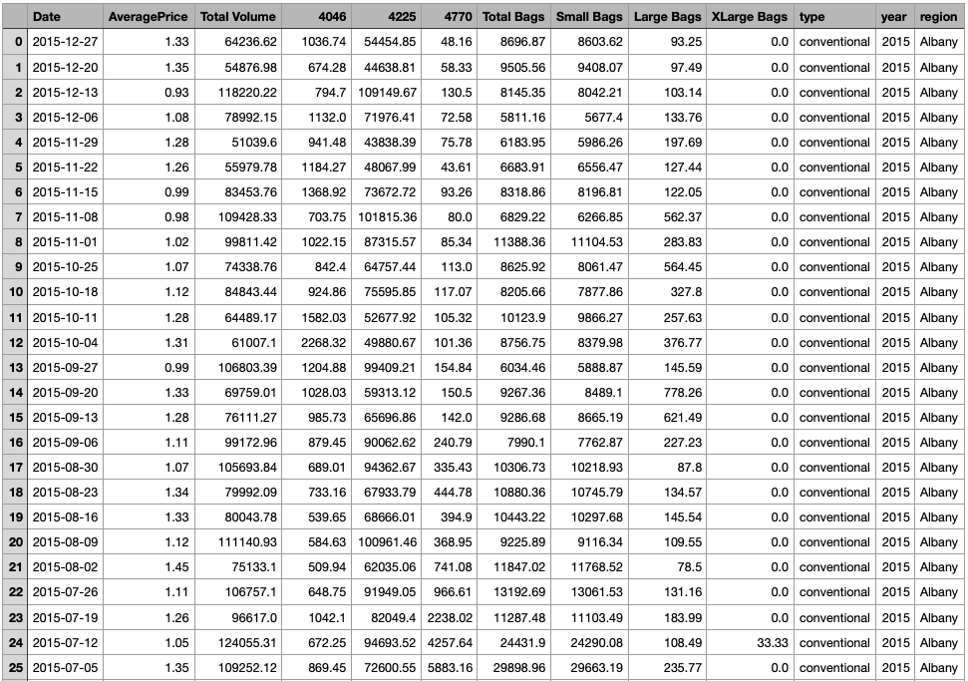
MAR653: Marketing Analytics - Analysis of Avocado Pricing and Distribution

Slide 13
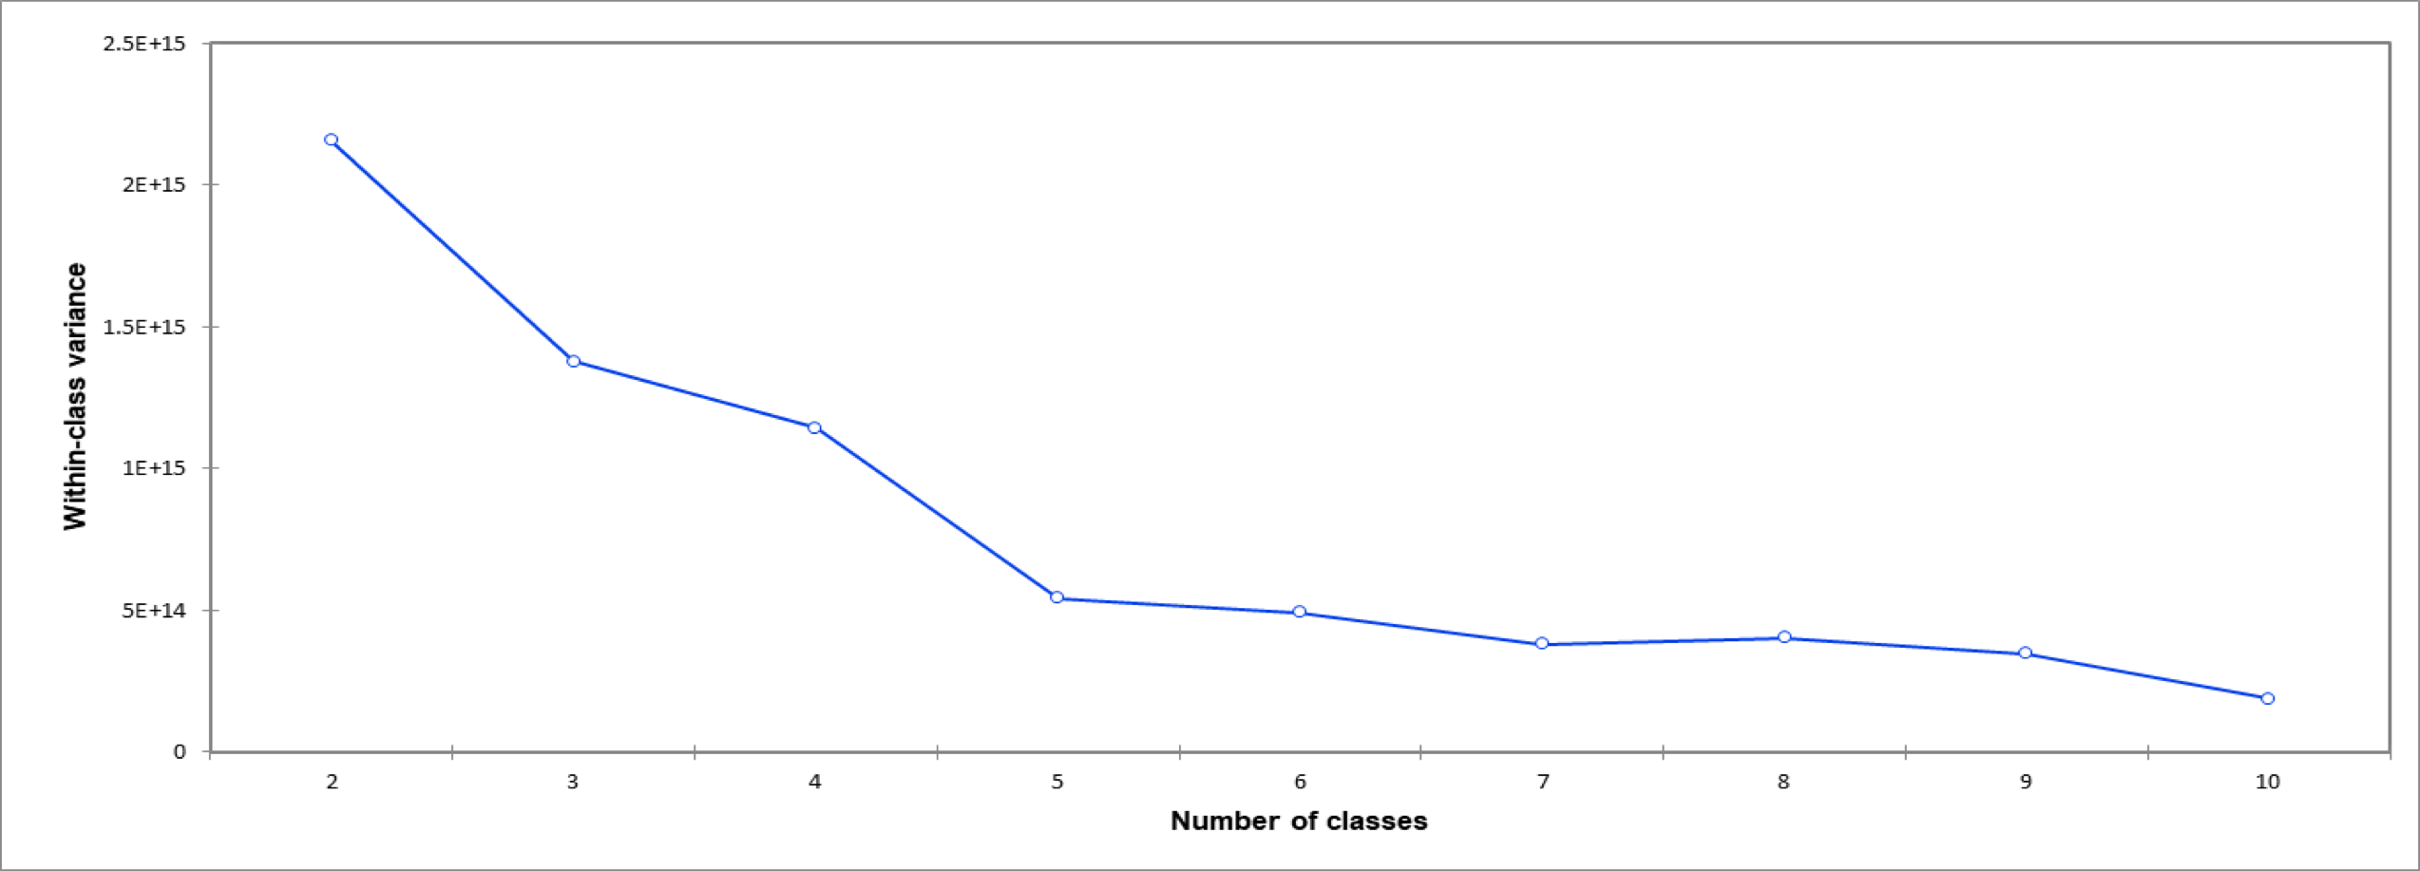
MAR653: Marketing Analytics - Analysis of Avocado Pricing and Distribution
K-Means revealed 5 segments of customers.

Slide 14
MAR653: Marketing Analytics - Analysis of Avocado Pricing and Distribution
Key Takeaways
The further you are from Mexico the more you pay.
“X-Large” has negative connotation in the sales of avocados.
Steady pricing in areas of low demand.
Organic avocados have high correlation to price.

Slide 15
MAR653: Marketing Analytics - Analysis of Avocado Pricing and Distribution
Learning Outcome
Identify avocado sales patterns via visualizations, statistical analysis, and data mining.
Developed alternative marketing strategies based on data.
Developed a plan of action to implement the business decisions based on data like elimination of “X-Large” and pricing segmentation.
Communication skills of data in form of presentation to other data-minded individuals.

Slide 16
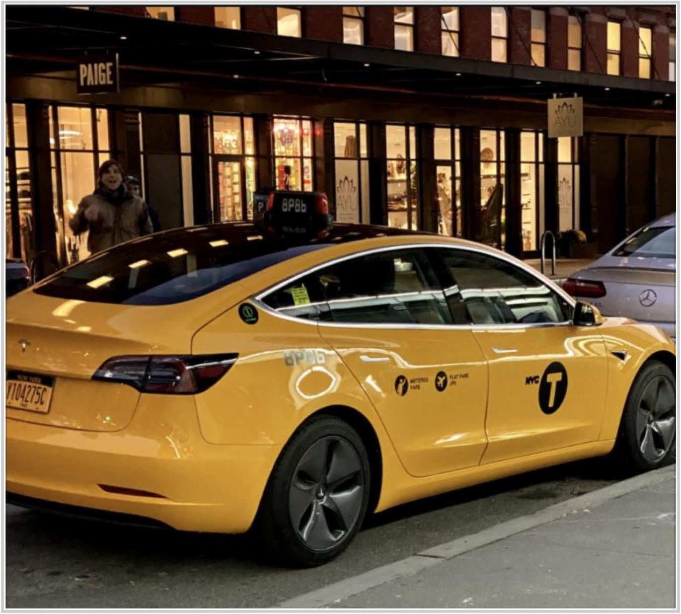
IST718: Big Data Analytics - NYC Taxi Duration
Best time to take a taxi in NYC?
Using public taxi data pulled kaggle.com
combine with collision data
combine with OSRM data (open source routing machine)

Slide 17
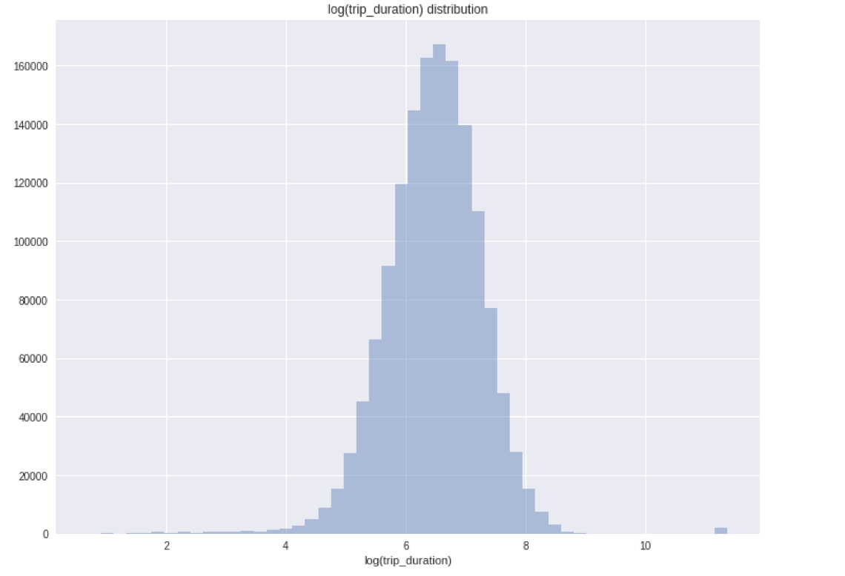
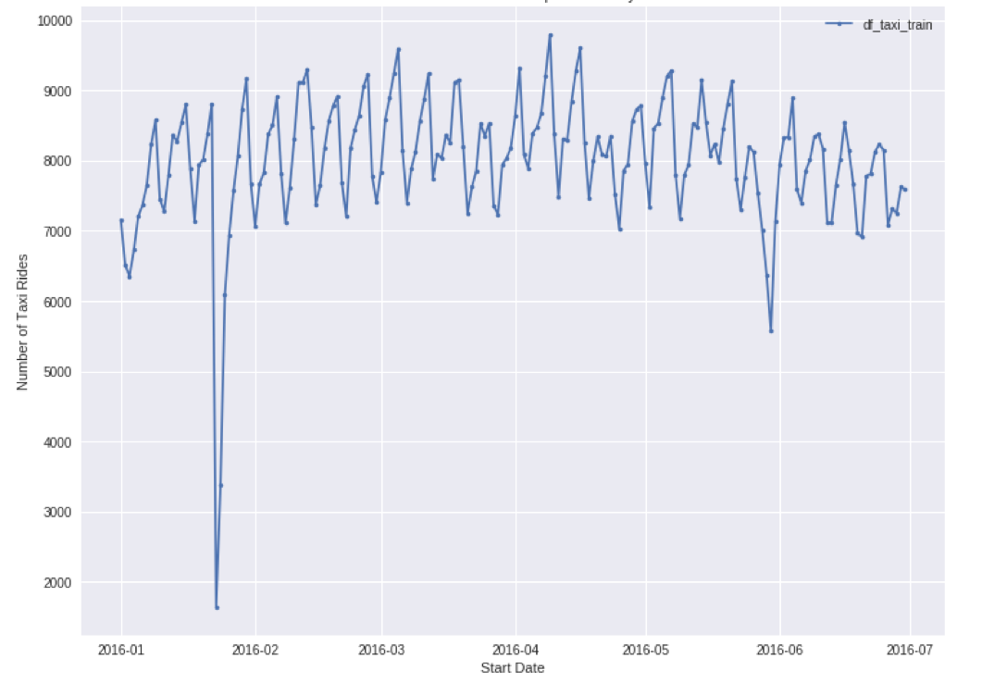
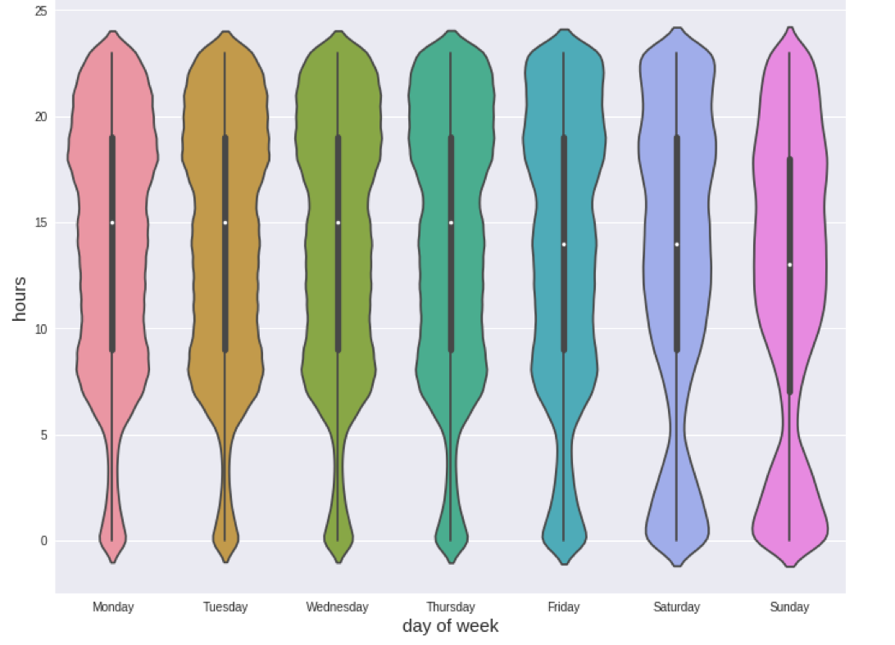
IST718: Big Data Analytics - NYC Taxi Duration
Count Trip Duration
Number of Taxi Rides Per Day
Count of Rides per Day per Hour

Slide 18
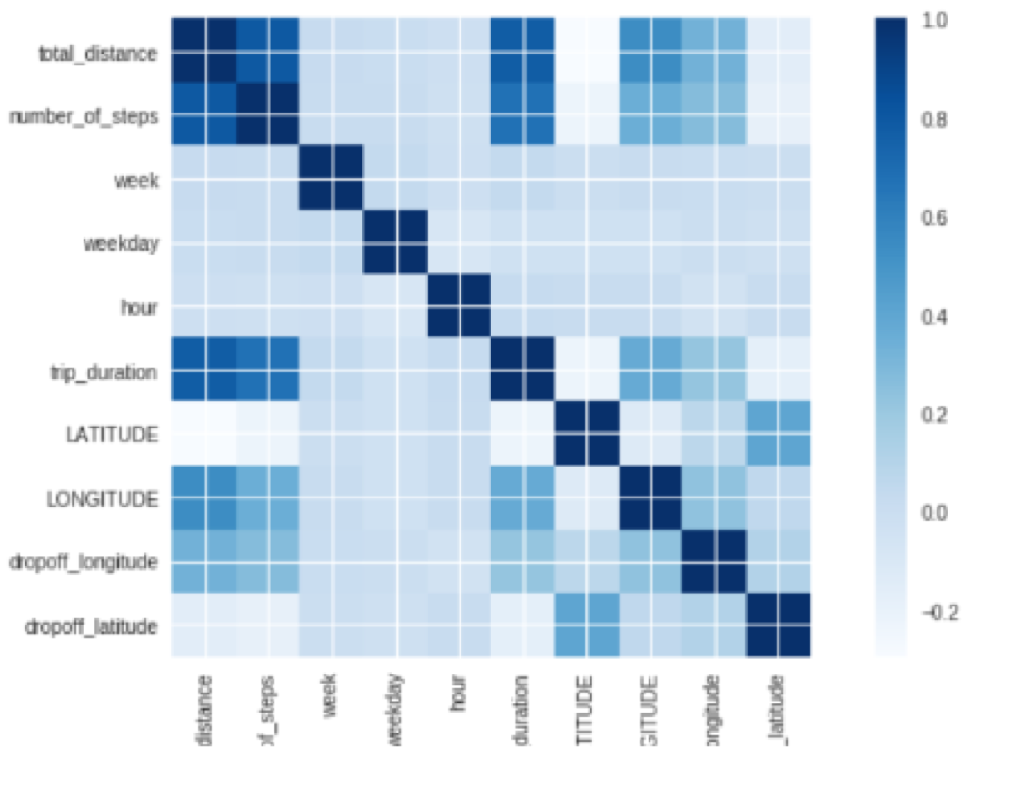
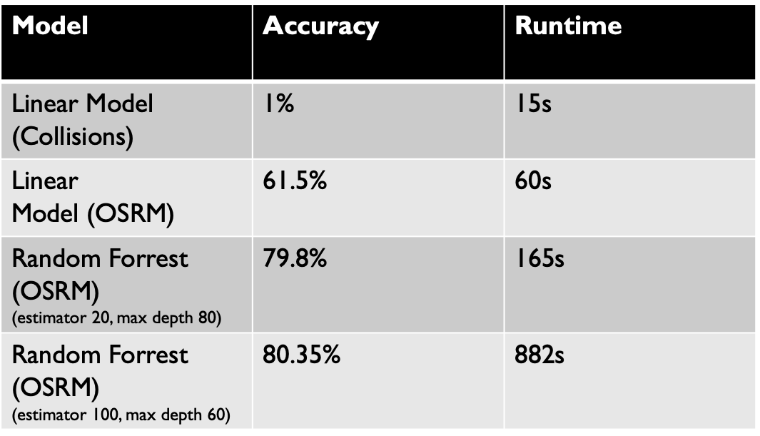
IST718: Big Data Analytics - NYC Taxi Duration
Correlation analysis
most obviously total distance is related to duration
Collisions are not strongly correlated to longer duration time.
In fact, optimized routing was one of the most influential factors.
Ran models for predictions

Slide 19
IST718: Big Data Analytics - NYC Taxi Duration
Learning Outcome
Using predictive models major practice area in data science.
Collect, combine, and organize different datasets.
Identify patterns in data via visualizations, statistical analysis, and data mining.
Develop alternative strategies based on data.
Communication skills of data in form of presentation to other data-minded individuals.

Slide 20
Conclusion
All the skills I have acquired from the applied data science program at Syracuse University have better prepared me for the wide range of problems related to data in the real world.
All seven learning objectives were addressed within these projects which is just a sampling of what I learned from the program.
Thank you to all faculty and staff that have helped me along the way!

